Slide 1
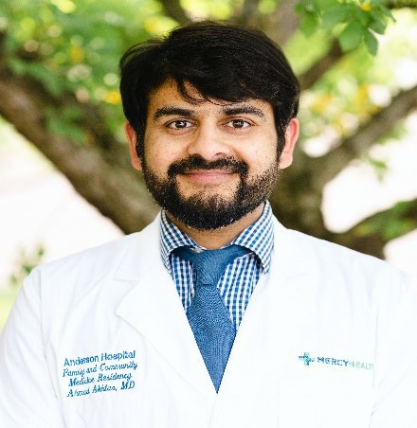
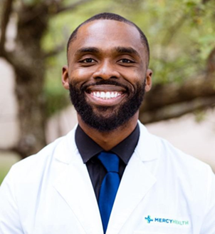
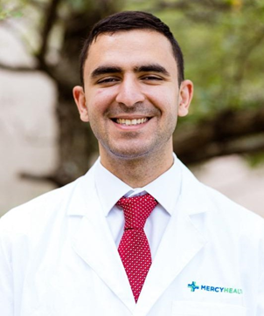
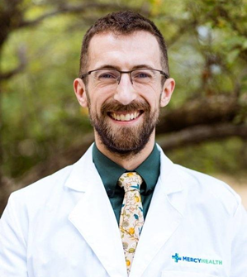
Ahmad Akhtar MD
Undergraduate: Indiana University-Purdue University Indianapolis (IUPUI)
Medical School: American University of Integrative Sciences School of Medicine
Hometown: New York, NY
Clinical Interests: Global Health
Hobbies/Personal Interests: 3D Printing, Raspberry Pi, and Videography
Grant Akalonu MD
Undergraduate: City University of New York - Lehman College
Medical School: University of Miami - Leonard M. Miller School of Medicine
Hometown: Bronx, NY
Clinical Interests: Academic Medicine and Addiction Medicine Personal Interests/Hobbies: Basketball, Exploring Parks, and Weightlifting
Ghaith Ati MD
Undergraduate: Xavier University School of Medicine - Aruba
Medical School: Xavier University School of Medicine - Aruba
Hometown: Windsor, Ontario, Canada
Clinical Interests: Sports Medicine
Personal Interests/Hobbies: Playing Guitar/Drums, Songwriting, and Running
Myles Barlow DO
Undergraduate: University of Michigan
Medical School: Michigan State University College of Osteopathic Medicine
Hometown: Midland, MI
Clinical Interests: Sports Medicine
Personal Interests/Hobbies: Nutrition/Healthy Living, Karate/Jodo, Board Games, and Hiking in Cincinnati

Slide 2
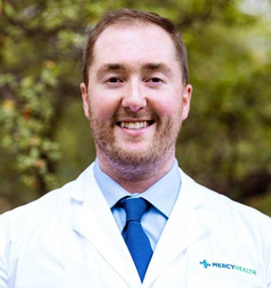
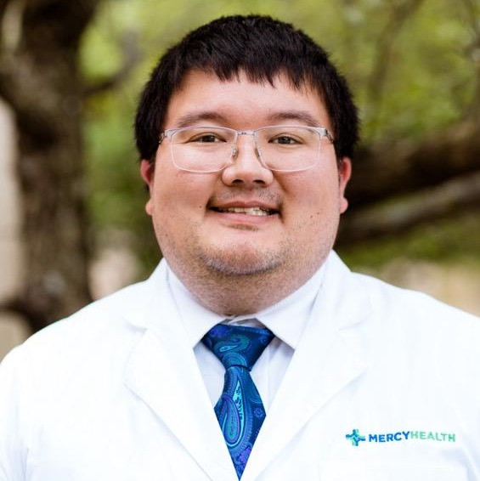
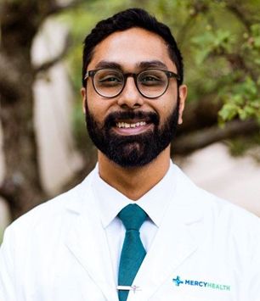
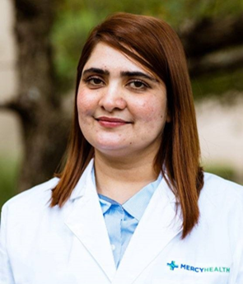
Zachary Cleaver DO
Undergraduate: Franklin College
Medical School: Marian University College of Osteopathic Medicine
Hometown: Lebanon, OH
Clinical Interests: Outpatient Family Medicine and Addiction Medicine
Personal Interests/Hobbies: Visiting Local Attractions with Friends/Family and Enjoying Competitive Sports and Games
Jonathan Pang DO- Lead Resident
Undergraduate: Kenyon College
Medical School: Marian University College of Osteopathic Medicine
Hometown: Lancaster, OH
Clinical Interests: Preventative Medicine, Addiction Medicine, and Rural Medicine
Personal Interests/Hobbies: Hiking with Wife and 2 Dogs, Music, Reading, and Playing Video Games
Maaz Siddique DO Undergraduate: Rutgers University
Graduate School: Rutgers University
Medical School: Rowan-Virtua School of Osteopathic Medicine
Hometown: Edison, NJ
Clinical Interests: Behavioral Health, Integrative Medicine, and Direct Primary Care
Personal Interests/Hobbies: Playing Guitar, Watching Horror Movies,
Exercising, or Playing Video Games
Fariha Shoukat MD- Lead Resident
Undergraduate: Suffah College (Pakistan)
Medical School: Fatima Jinnah Medical University (Pakistan)
Post-Graduate Training: College of Physicians & Surgeons Pakistan (OB/ GYN)
Hometown: Lahore, Pakistan
Clinical Interests: Undecided vs. Hospital Medicine
Personal Interests/Hobbies: Spending Time with Friends/Family, Cooking, Knitting, Breakfast, Movies, and Board Games

Slide 3
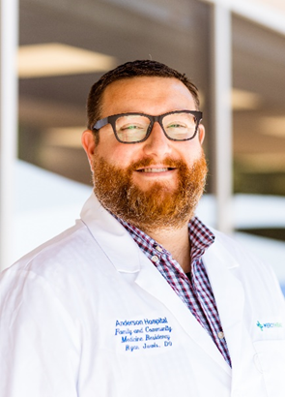
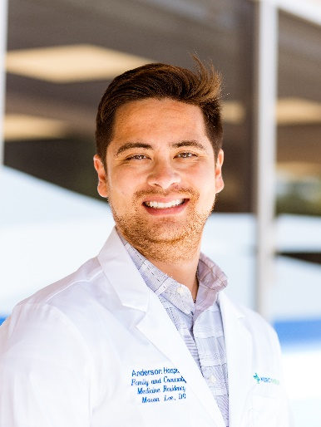
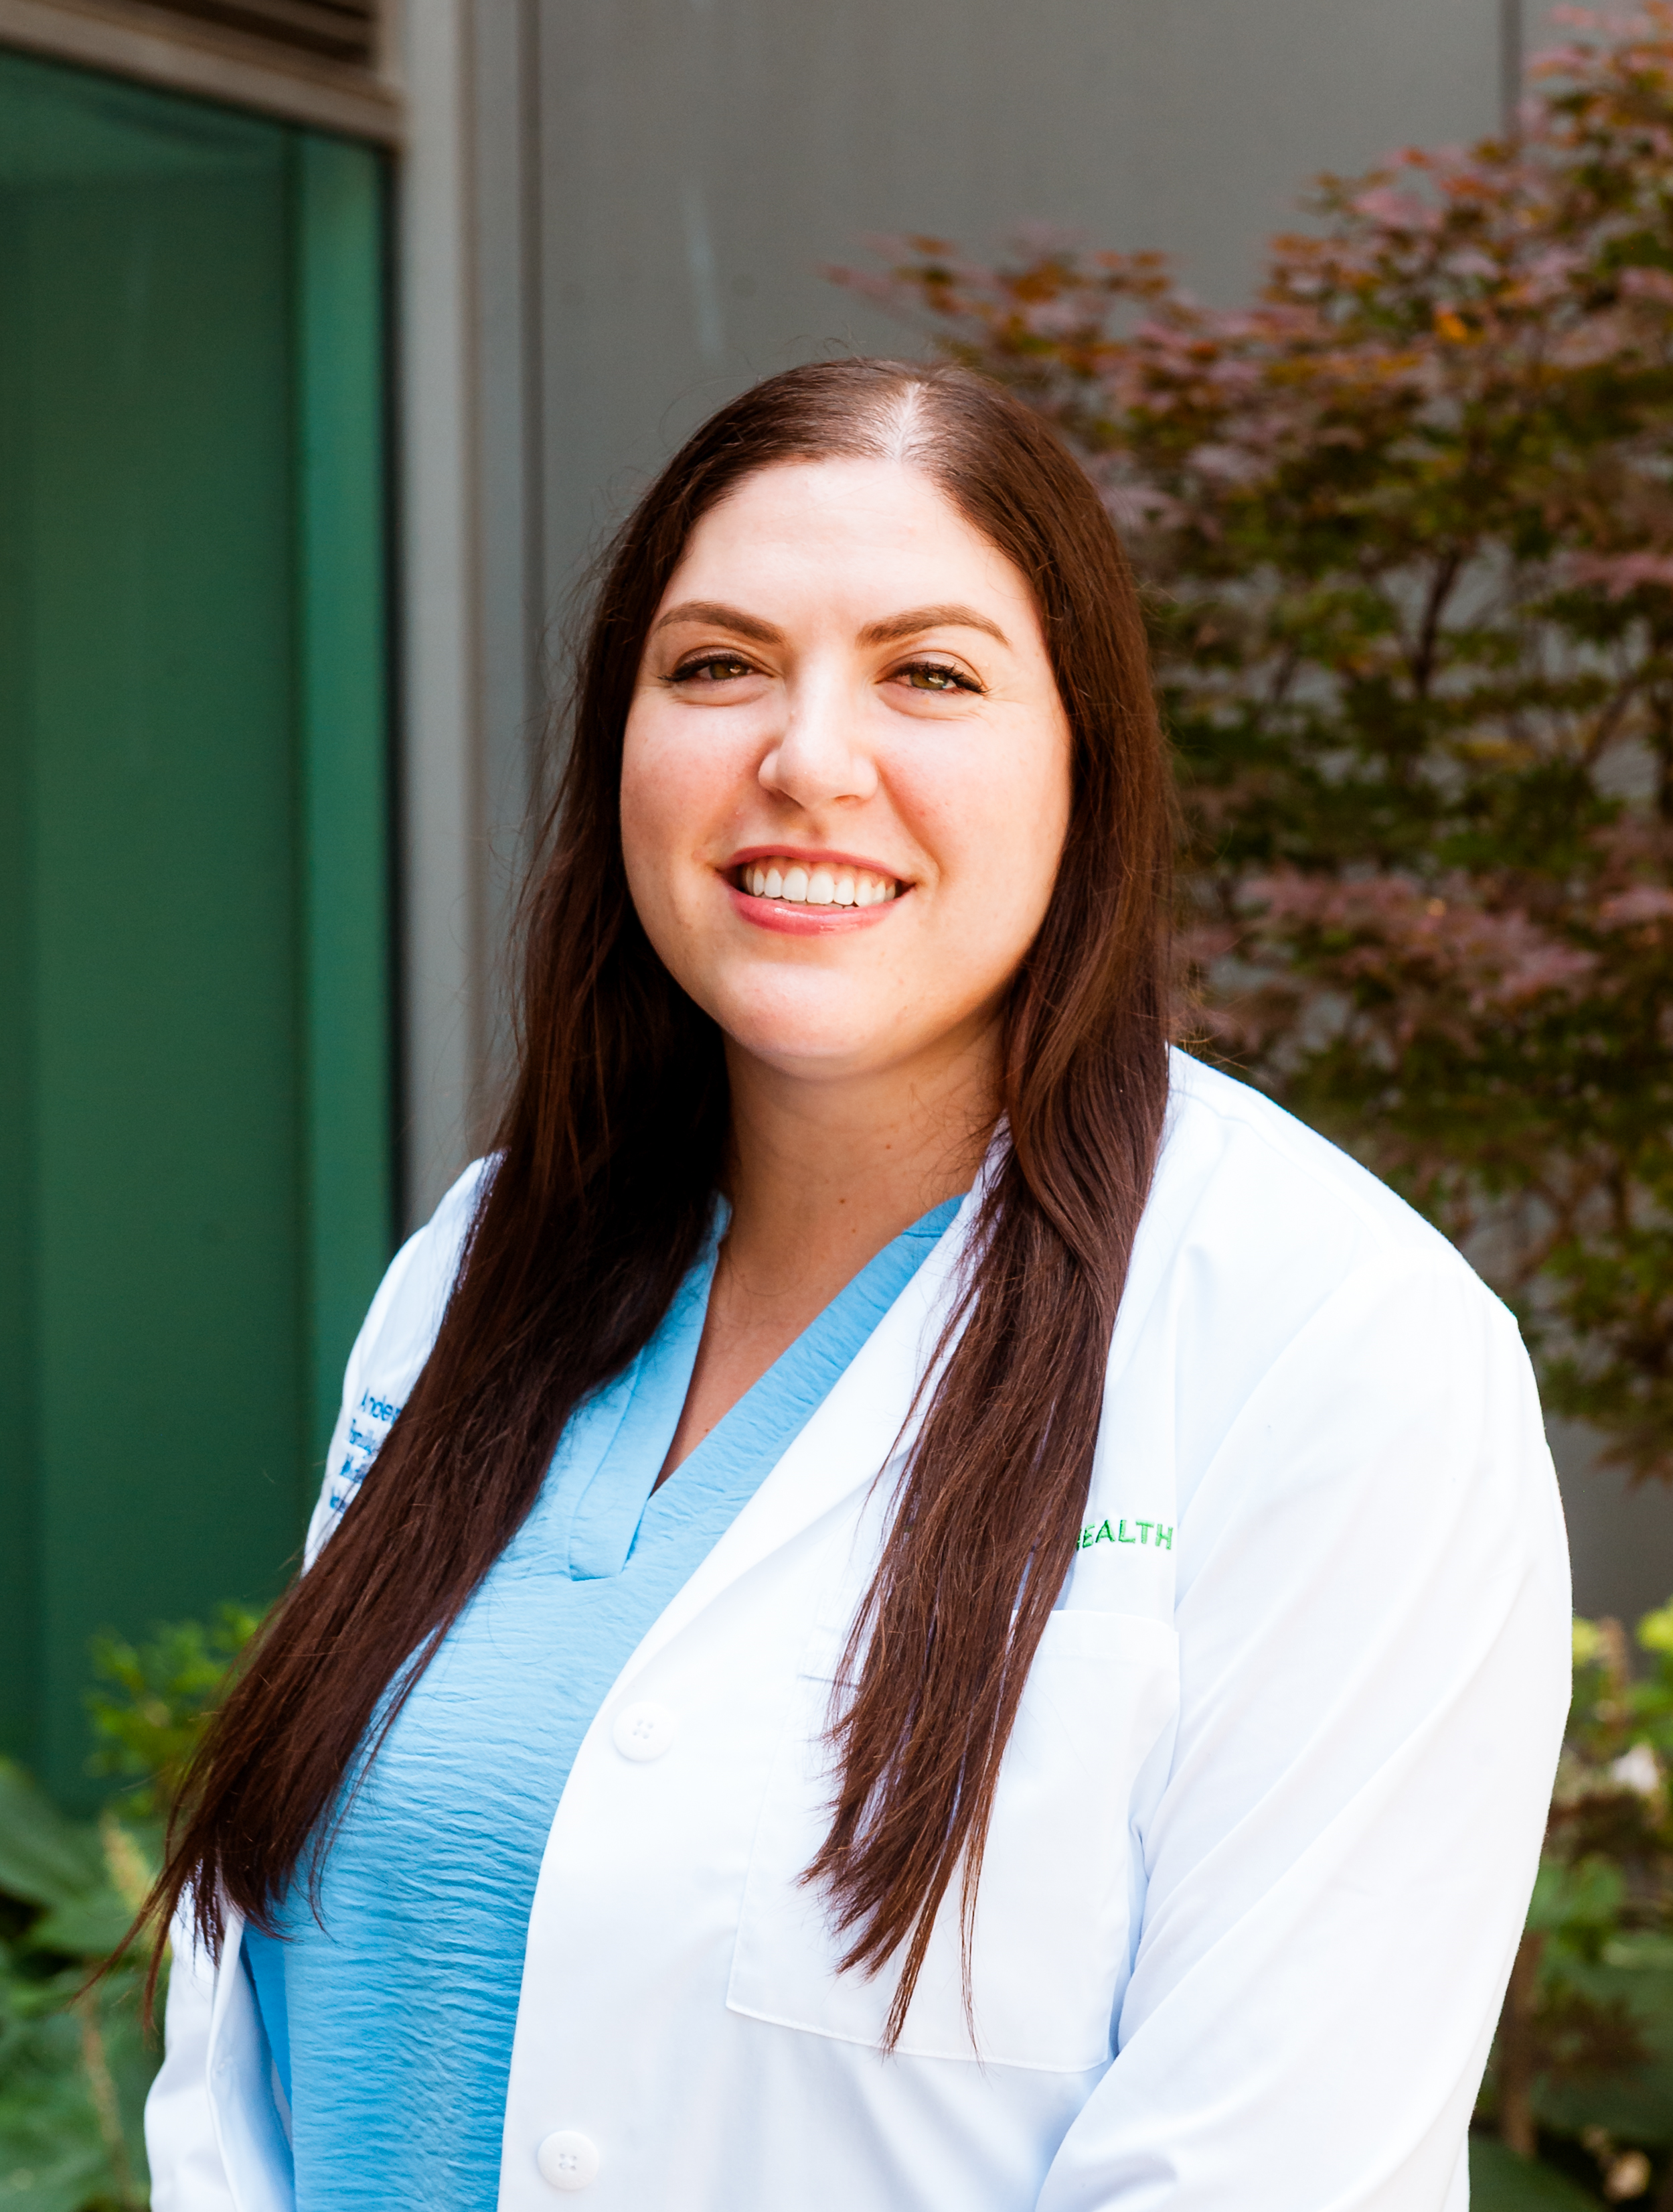
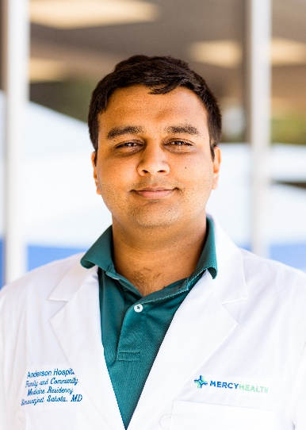
Ryan Jarvis DO
Undergraduate: NKU and University of Cincinnati
Graduate School: University of Southern California
Medical School: Arkansas College of Osteopathic Medicine
Hometown: Cincinnati, OH
Clinical Interests: Sleep Medicine, Inpatient, Outpatient
Hobbies/Personal Interests: Soccer. Huge Arsenal fan. All things Cincy sports- Bengals, Reds, UC bearcats. Trivia nights. Golf. Travel. Foodie. Movies. Breweries/wineries. Playing Playstation. My fiancée and our golden retriever.
Mason Lee DO
Undergraduate: DePauw University
Medical School: Marian University Wood College of Osteopathic Medicine
Hometown: South Bend, Indiana
Clinical Interests: Sports Medicine, Outpatient Family Medicine, and Behavioral Health.
Personal Interests/Hobbies: Tennis, basketball, pickleball, watching NFL, singing, travelling, home-cooking, escape rooms.
Sydney Molenaar DO- Junior Lead
Undergraduate: Barrett, the Honors College at Arizona State University
Medical School: Nova Southeastern University Dr. Kiran C. Patel College of Osteopathic Medicine
Hometown: Scottsdale, AZ
Clinical Interests: Women's Health and Outpatient Medicine
Personal Interests/Hobbies: My interests include soccer, dance, hiking, traveling, reading, and cooking! I am also a huge Disney fan and have a Disney World annual pass. I have visited 15 National Parks (and counting).
Simaranjeet Sahota MD
Undergraduate: University of Cincinnati
Medical School: University of Kentucky College of Medicine
Hometown: West Chester, OH
Clinical Interests:
Personal Interests/Hobbies: I enjoy home improvement tasks varying from painting to electrical work and have taught myself various skills. I enjoy playing board and video games with my friends, from strategy games to games of creativity and humor. I enjoy cooking new dishes, especially for my vegan girlfriend.

Slide 4
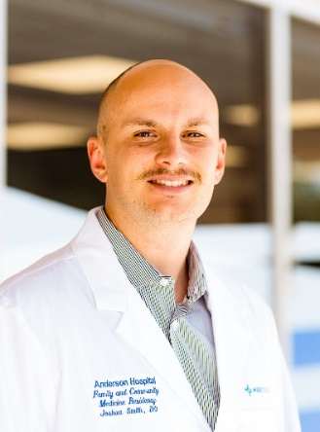
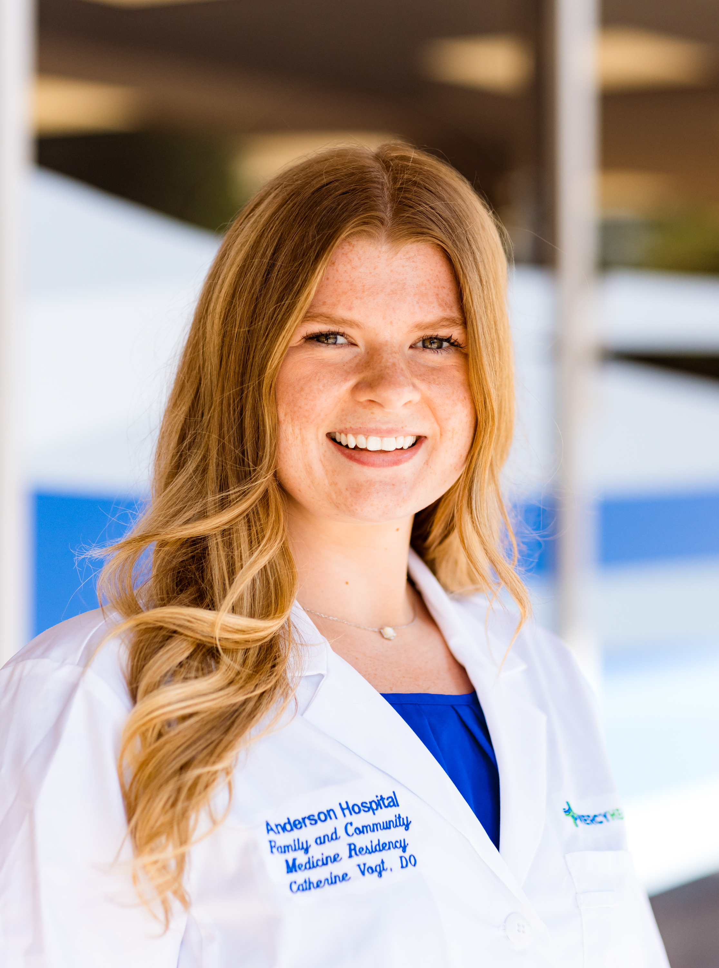
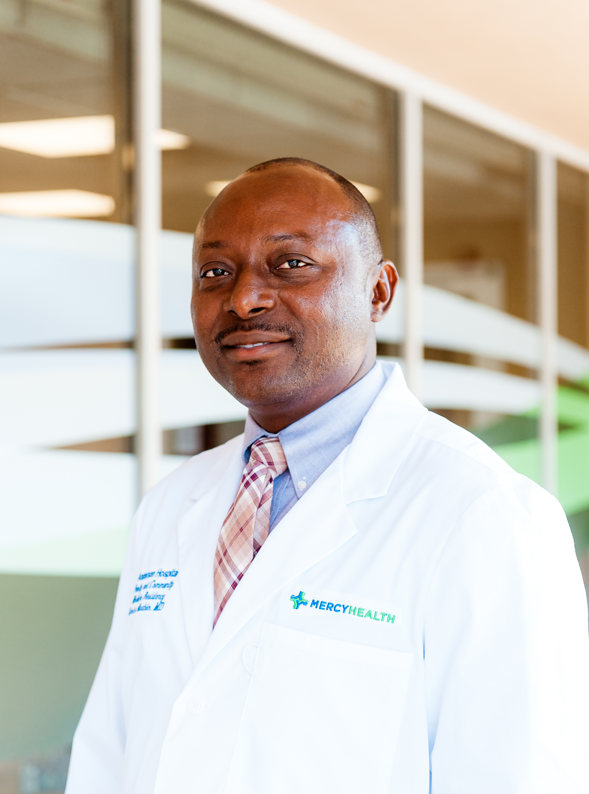
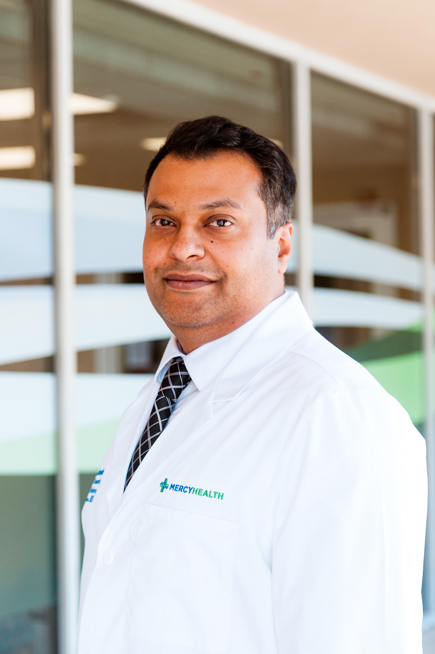
Joshua Smith DO
Undergraduate: Harding University
Medical School: New York Institute of Technology College of Osteopathic Medicine
Hometown: Middlebourne, WV
Clinical Interests: Global Medicine
Personal Interests/Hobbies: I spend as much time as possible in the outdoors: fishing, foraging, and recently, running. On rainy days I like to spend time inside reading or tying flies.
Catherine Vogt DO- Junior Lead
Undergraduate: Miami University
Medical School: University of Pikeville- Kentucky College of Osteopathic Medicine
Hometown: Lexington, KY
Clinical Interests: Rural Medicine, Pediatrics, and Women’s Health
Personal Interests/Hobbies: My hobbies include music, theater, hiking, and exercise. These are activities that I have been dedicated to from a young age and enjoy exploring in my free time as I have found them to be very beneficial for my mental and physical health. I also enjoy trivia and board games, as well as movie nights with friends.
Charles Ababio MD
Undergraduate: University of Ghana
Medical School: University of Ghana School of Medicine and Dentistry
Hometown: Kumasi, Ghana
Clinical Interests: Primary Care and Academic Medicine
Personal Interests/Hobbies: I enjoy signing, listening to music and playing the piano. I also enjoy reading medical literature.
Ali Ahsan Dogar MD
Medical School: Shalamar Medical & Dental College Pakistan
Graduate: Manchester Metropolitan University, England
Hometown: Lahore, Pakistan
Clinical Interests: Primary Care and Rural Medicine
Personal Interests/Hobbies: I enjoy reading nonfiction books on personal development and lifelong learning. I also enjoy reviewing the financial statements of publicly traded companies, interpreting financial data, and practicing value investing. Additionally, I have a strong interest in flying because it offers a unique sense of freedom while combining adventure, discipline, and thoughtful decision-making.

Slide 5
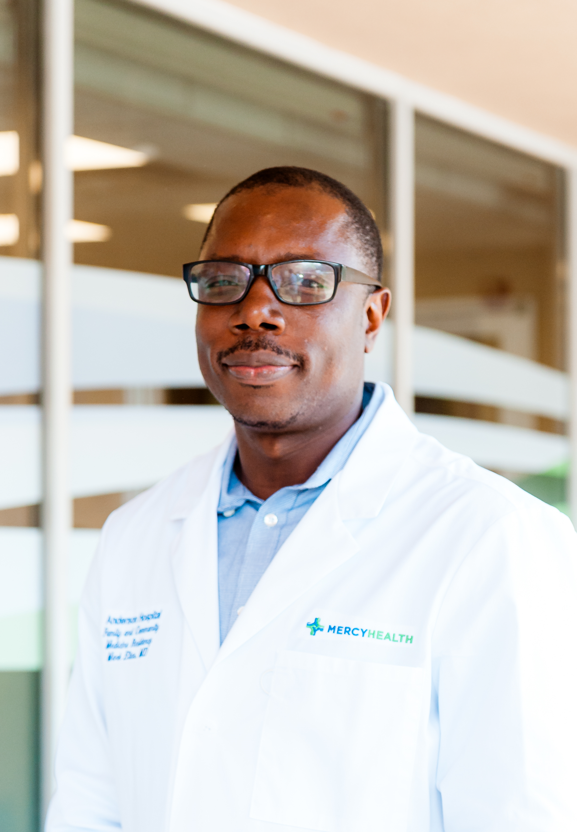
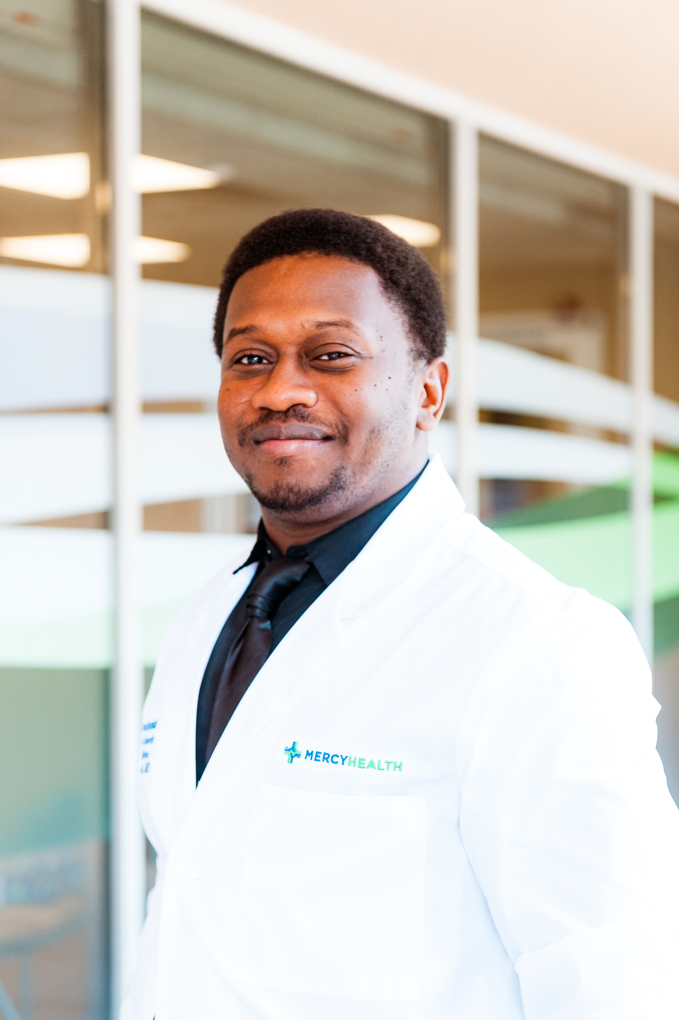
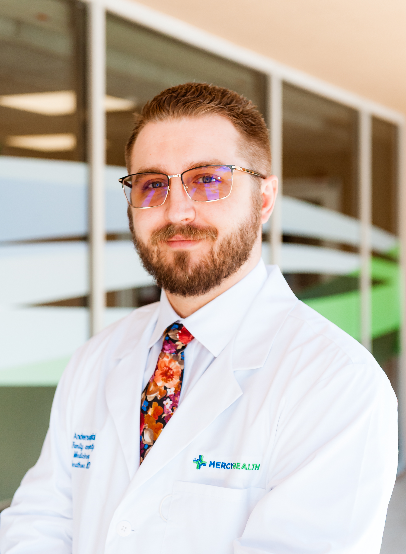
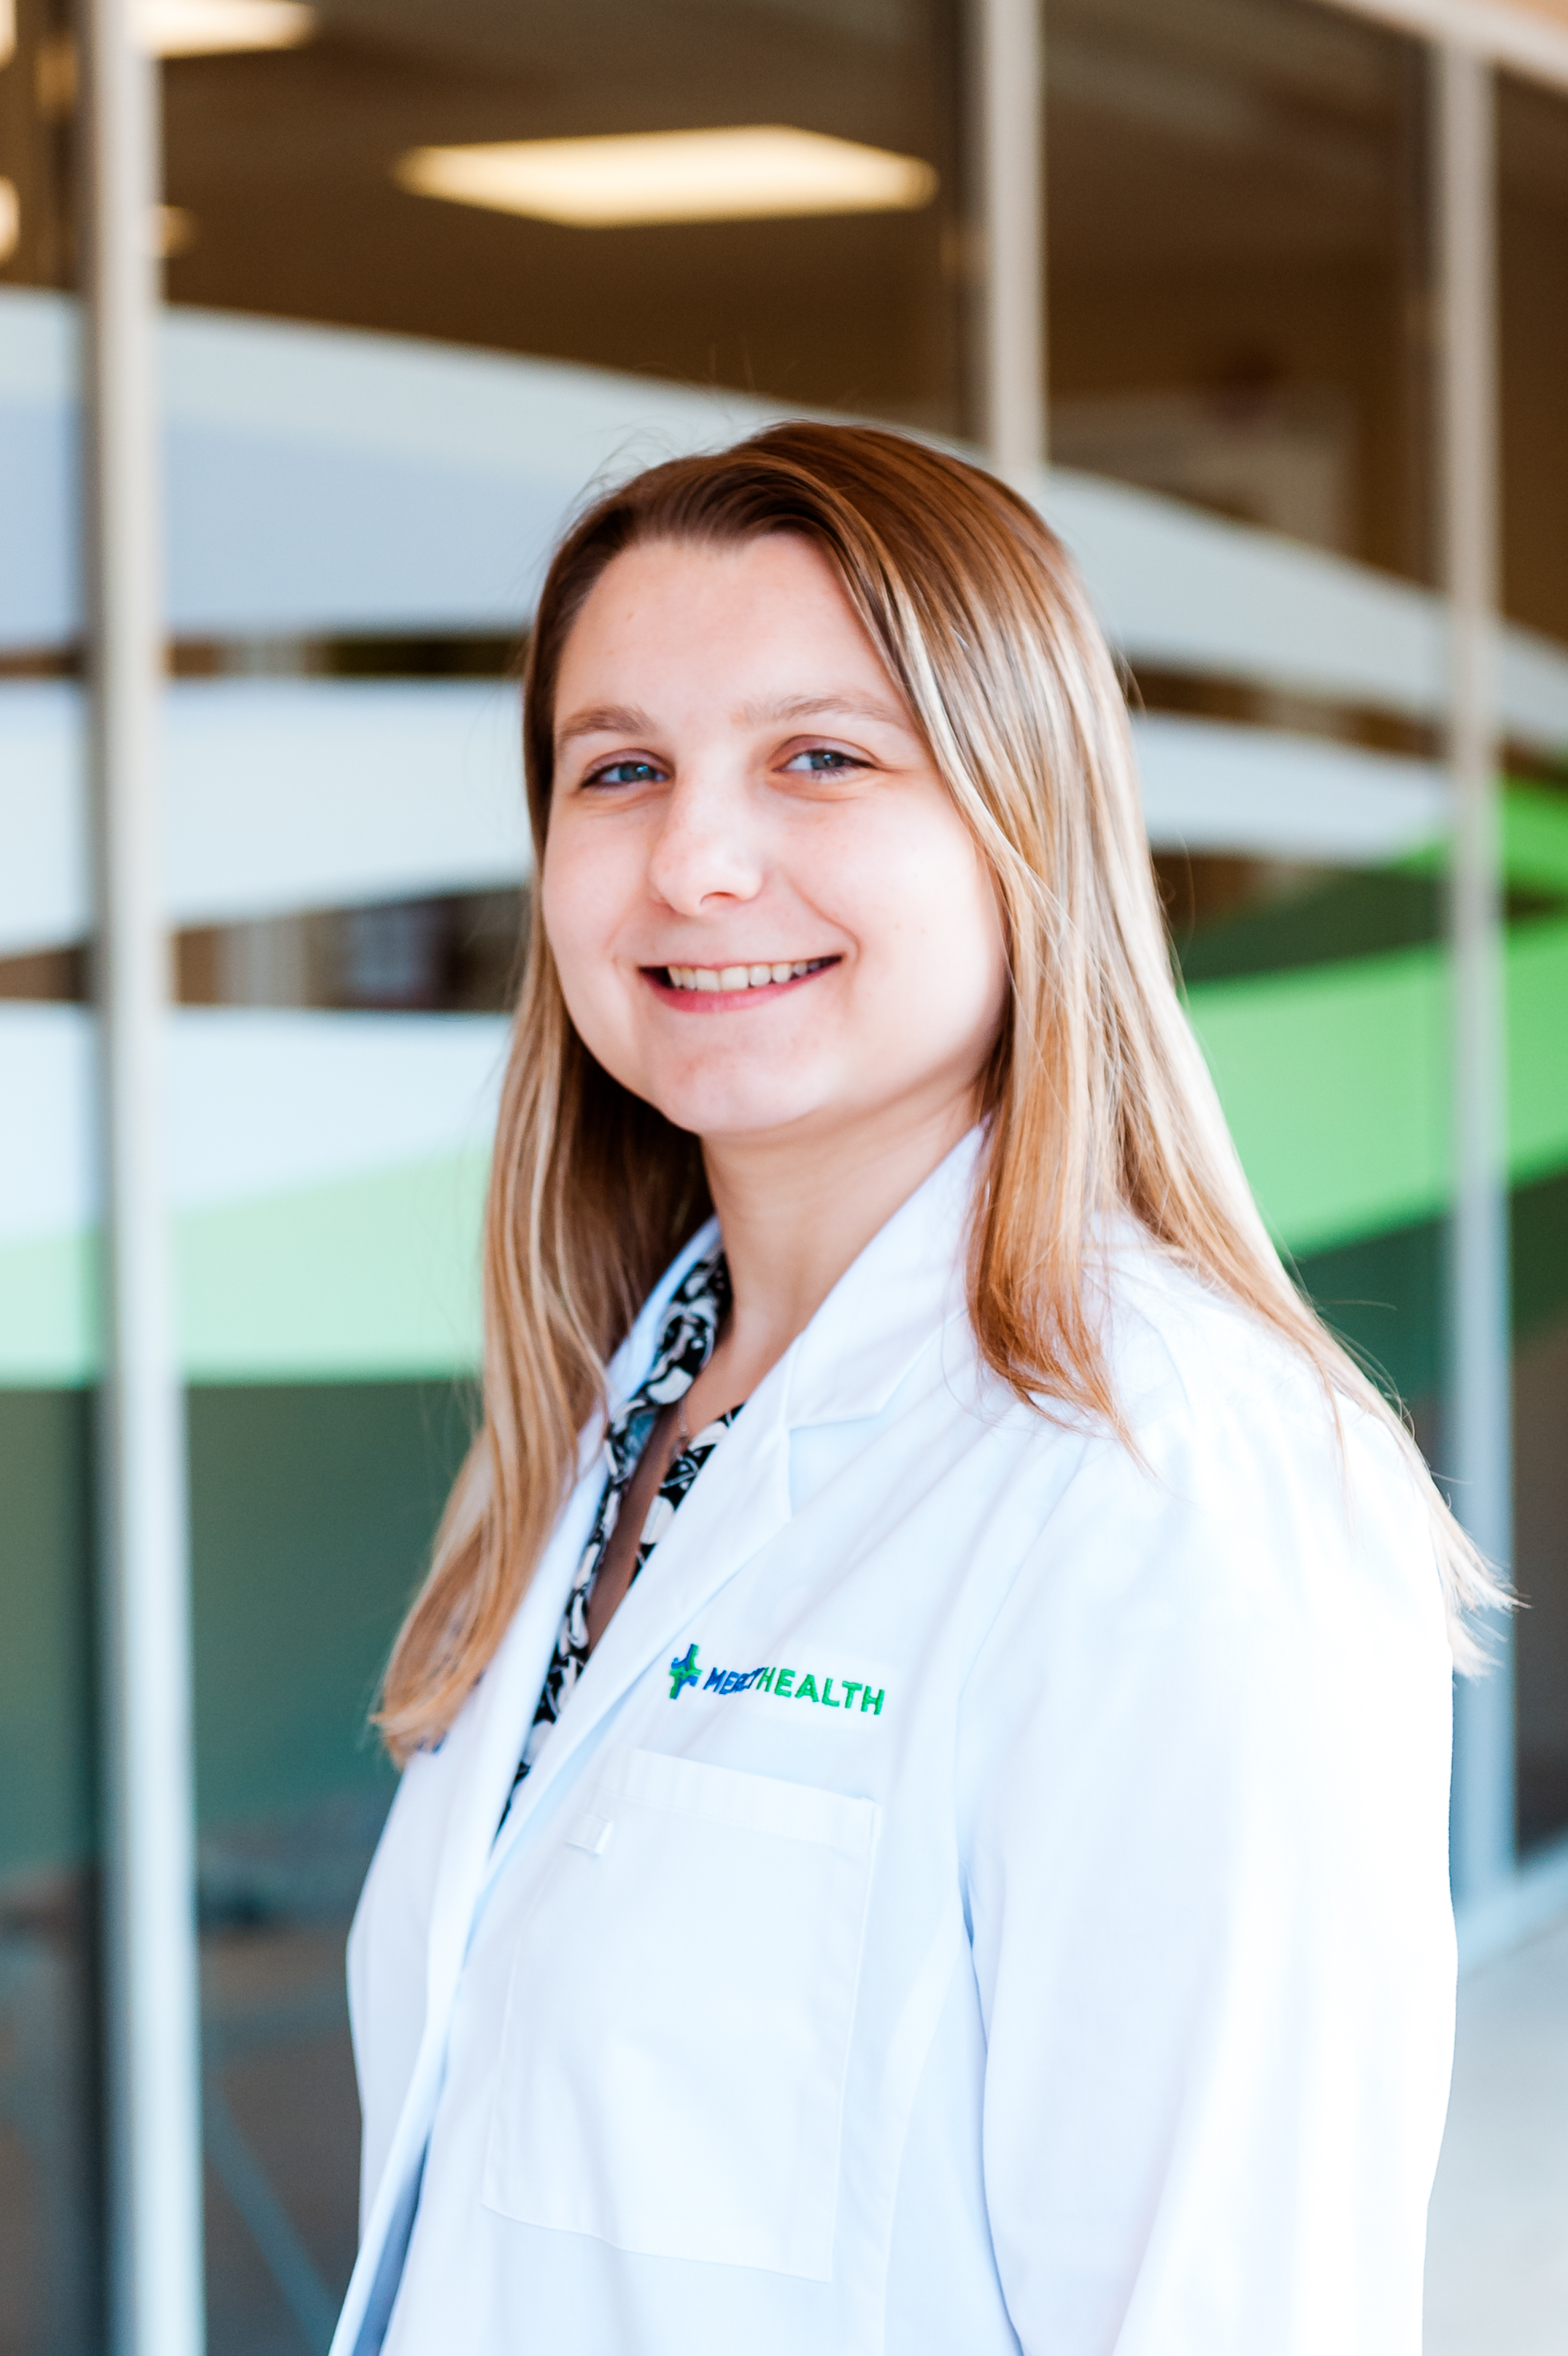
Mark Elias MD
Medical School: Escuela Latinoamericana de Medicina
Hometown: Georgetown; Guyana
Clinical Interests: Inpatient and Outpatient Medicine
Personal Interests/Hobbies: Lawn Tennis: When I’m not serving up diagnoses, I’m serving up aces and usually winning. Cooking: I bake and cook a wide range of foods, primarily Guyanese cuisine, including cook-up rice and pepper pot. Track and Field: I am an avid track and field enthusiast.
Axler Jean Paul MD
Medical School: Université d'Etat d'Haïti Faculté de Médecine et de Pharmacie
Hometown: Juvenat, Petion-ville; Haiti
Clinical Interests: Sleep Medicine, Lifestyle Medicine, Clinical research/Epidemiology
Personal Interests/Hobbies: Huge fan of soccer, I play as a right back in local matches and enjoy weekend games to stay active, build camaraderie, and relax after intense work or study. It helps me recharge mentally while reinforcing the value of teamwork, resilience and shared goals, as in medical practice.
Jonathon Phillipp MD
Medical School: Wright State University Boonshoft of Medicine
Undergraduate: Wright State University
Hometown: Beavercreek, Ohio
Clinical Interests: Preventive Medicine, Hospice and Palliative Care
Personal Interests/Hobbies: I love to play Dungeons and Dragons and board/card games with friends. Additionally, I enjoy trying different seasonal sporting activates such as snowboarding in the winter and sand volleyball in the summer. Most recently I have taken up golfing and, as a result, I am also becoming a fan of hiking.
Megan Simpson DO
Medical School: Marian University Wood College of Osteopathic Medicine
Graduate: Marian University
Undergraduate: University of Toledo
Hometown: Maumee, OH
Clinical Interests: Outpatient Family Medicine, Behavioral Health, and Endocrinology
Personal Interests/Hobbies: I love discovering new music and curating new playlist in Spotify. My go to music is indie-pop, but I like all kinds of music. My other big hobby is reading. I love thrillers and mystery novels the most. I am an Ohio State Football fan and enjoy going to various sporting events in my free time.

